Slide 1
Eco-Action

Slide 2
“Greening” (Viriditas of Hildegard of Bingen)
Greening our churches or Building an Earth-centered community does not happen over night.
What I mean by “greening” is the transformation and conversion of yourself and your congregation to live responsibly, compassionately, and caring for the Earth and all other life. It will be a spiritual process that will be life-long within yourself and your church. And it will contribute to the “greening” of the United Church of Christ and beyond.

Slide 3
If we fall in love with God’s Earth, we will fight to preserve the Earth against human violence and exploitation
It must start with a conversion of ourselves, groups within or community to the Association and Conference Level to the Denomination.
“But I believe that the more clearly we can focus our attention on the wonders and realities of the world around us, the less taste we shall have for destruction.” Rachel Carson

Slide 4
“Eventually only our sense of the sacred will save us.” Thomas Berry
“The forms and individual characters of living and growing things, of inanimate things, of animals and flowers and all nature constitute their holiness in the sight of God.” Thomas Merton

Slide 5
Lectio Divina with the Book of Nature
At the time I was eleven years old. My family was moving from a more settled part of a small southern town out to the edge of town where the new house was being built. The house, not yet finished, was situated on a slight incline. Down below was a small creek and there across the creek was a meadow. It was an early afternoon in late May when I first wandered down the incline, crossed the creek, and looked out over the scene. The field was covered with white lilies rising above the thick grass. A magic moment, this experience gave to my life something that seems to explain my thinking at a more profound level than almost any other experience I can remember. It was not only the lilies. It was the singing of crickets and the woodlands in the distance and the clouds in a clear sky... Thomas Berry

Slide 6
Covenant with the Earth
We, the (Church Name), proclaim our love for God's Creation and profess our belief that the Earth, ourselves, and all life are an interconnected as part of the sacred Web of Life. We acknowledge that the Web of Life is the Body of the risen Christ.
We covenant together to commit ourselves as a church and individuals in the great work of healing, preservation and justice as we strive to reduce our individual and collective negative impact on the environment and to repair the damage that has been done to God's Earth. In worship and church life we will express our appreciation and give praise for the Earth and display a reverence for the Earth community of life.

Slide 7
We commit ourselves to Earthcare and to the biblical principles of taking only what we need, and heal the harm to Earth we do, and keep the Earth in repair for the future. We realize that we belong to the Earth and that the Earth is a member of our church.
We make this covenant in the hope and faith that through our Earth care we will be able to help improve and sustain the health of the land, air and water for the benefit of all current and future inhabitants of this Planet. Amen!

Slide 8
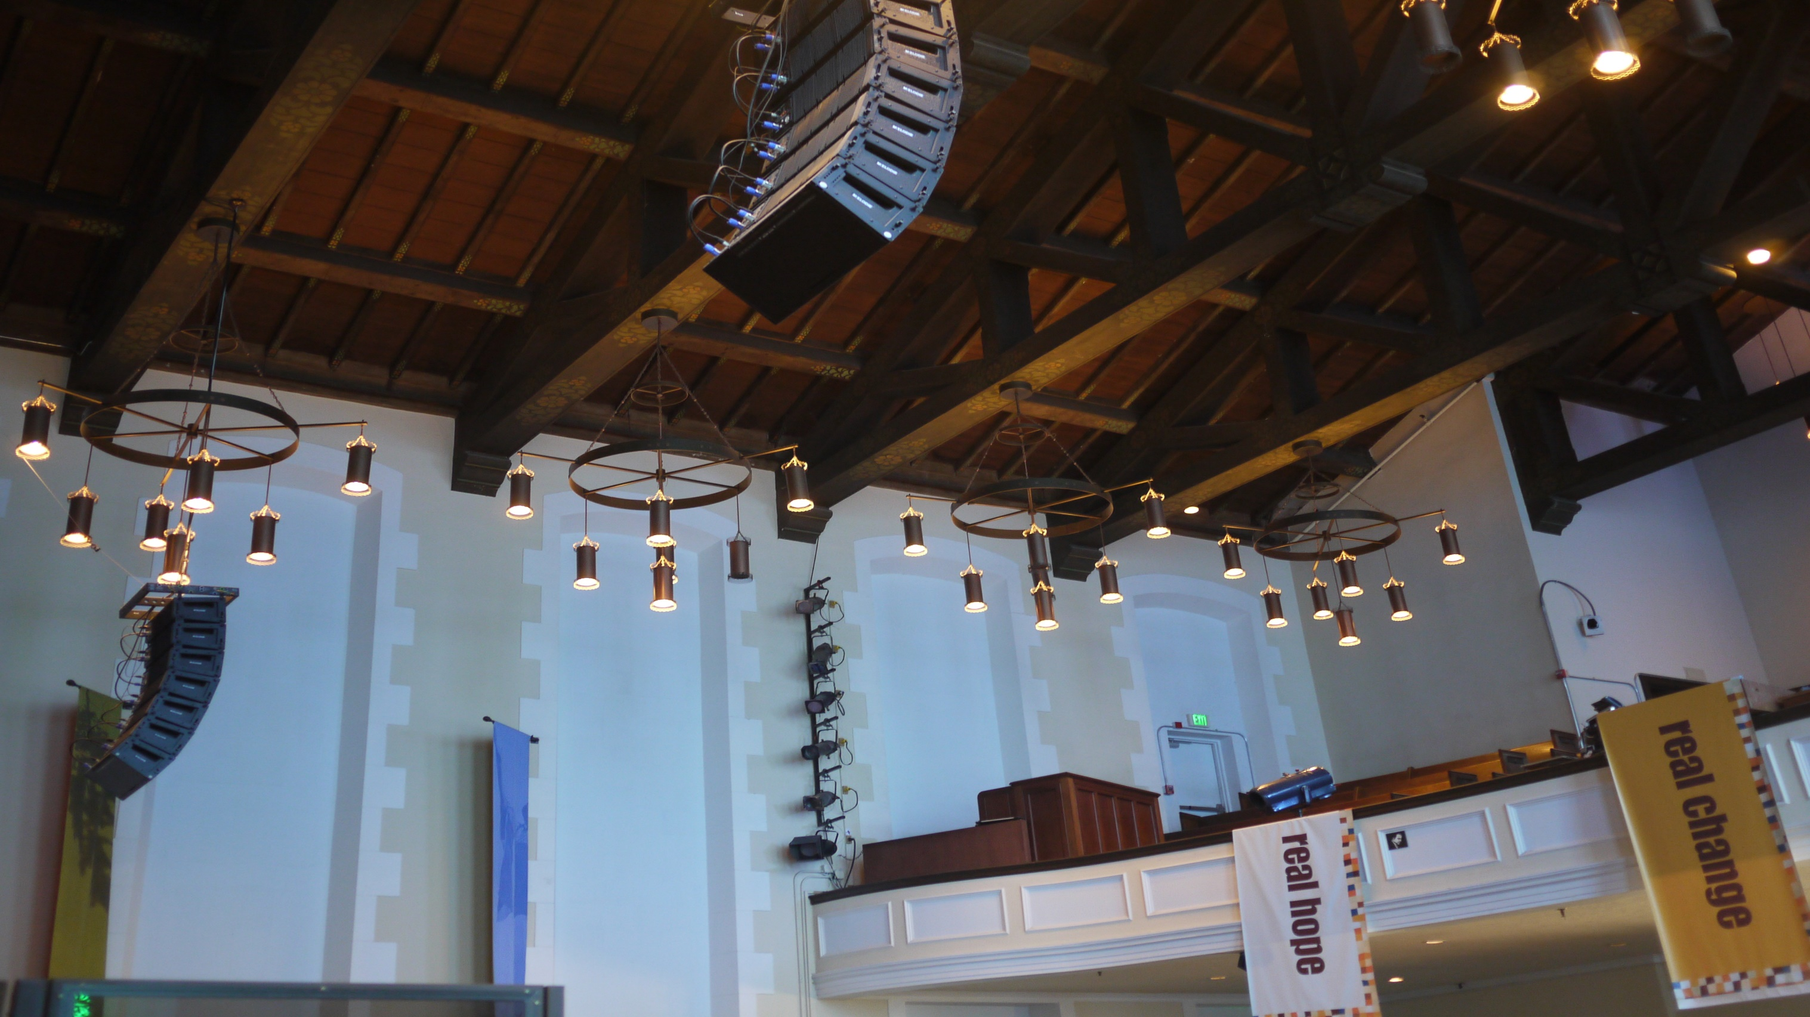
ENERGY EFFICIENCY
Notes:
Dubbed “Glide Heritage Space”, this area uses

Slide 9
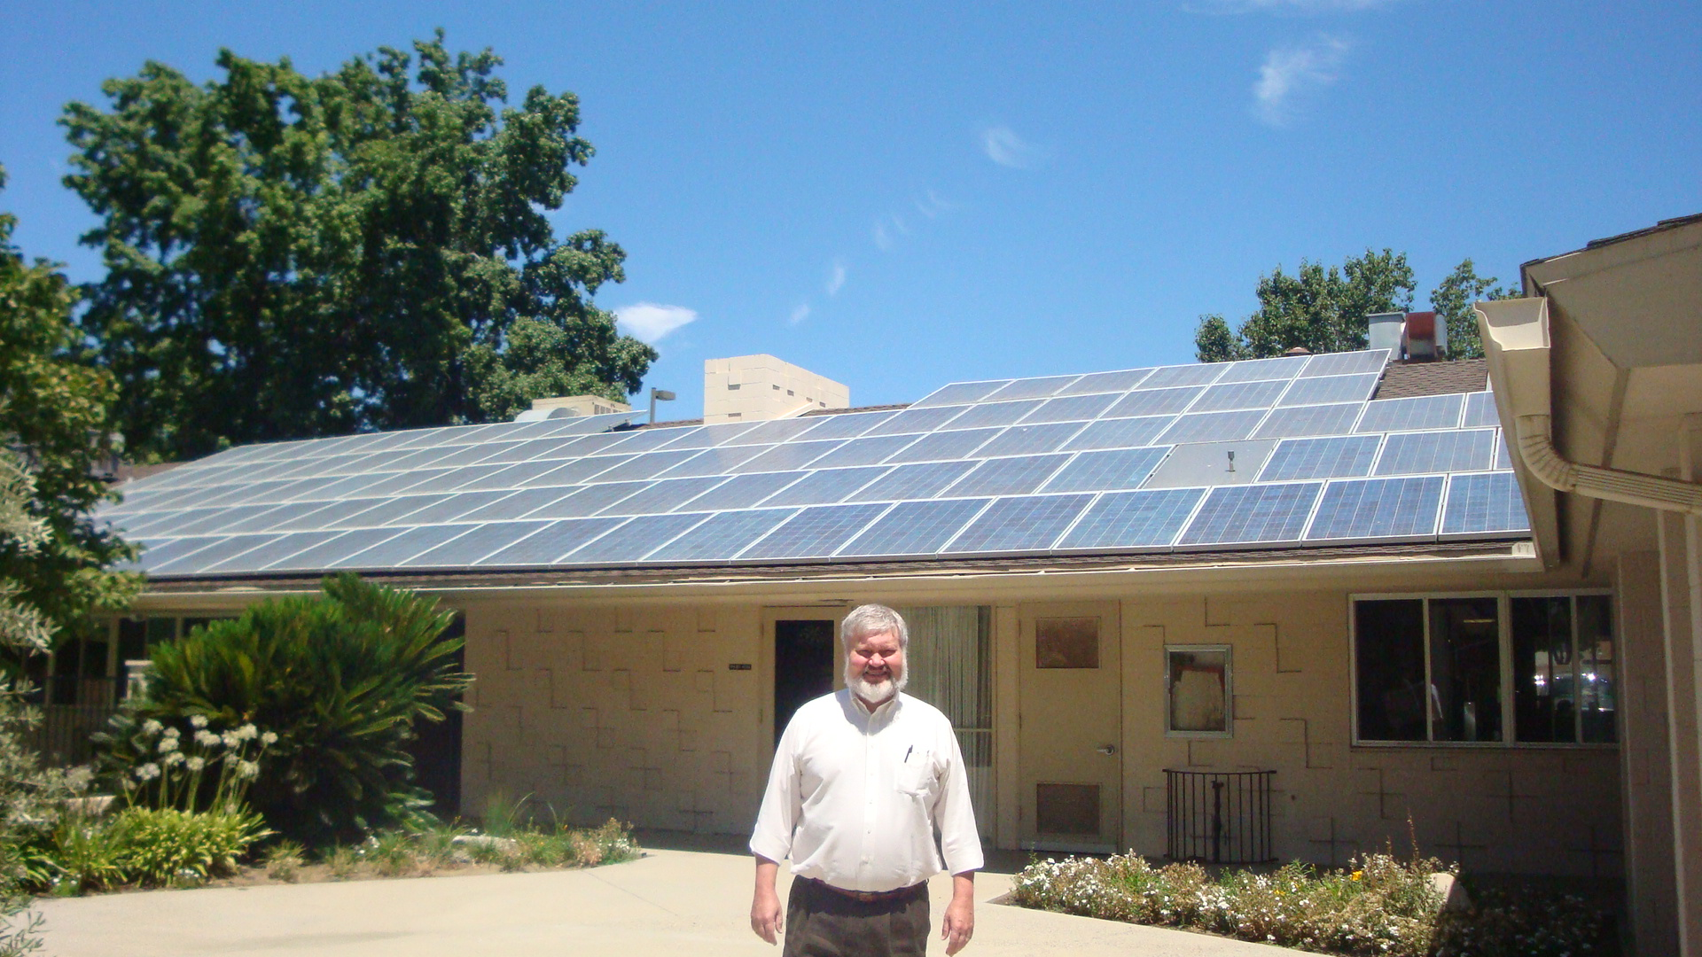
RENEWABLE ENERGY
Notes:
in an area of Los Angeles that receives more than its fair share

Slide 10
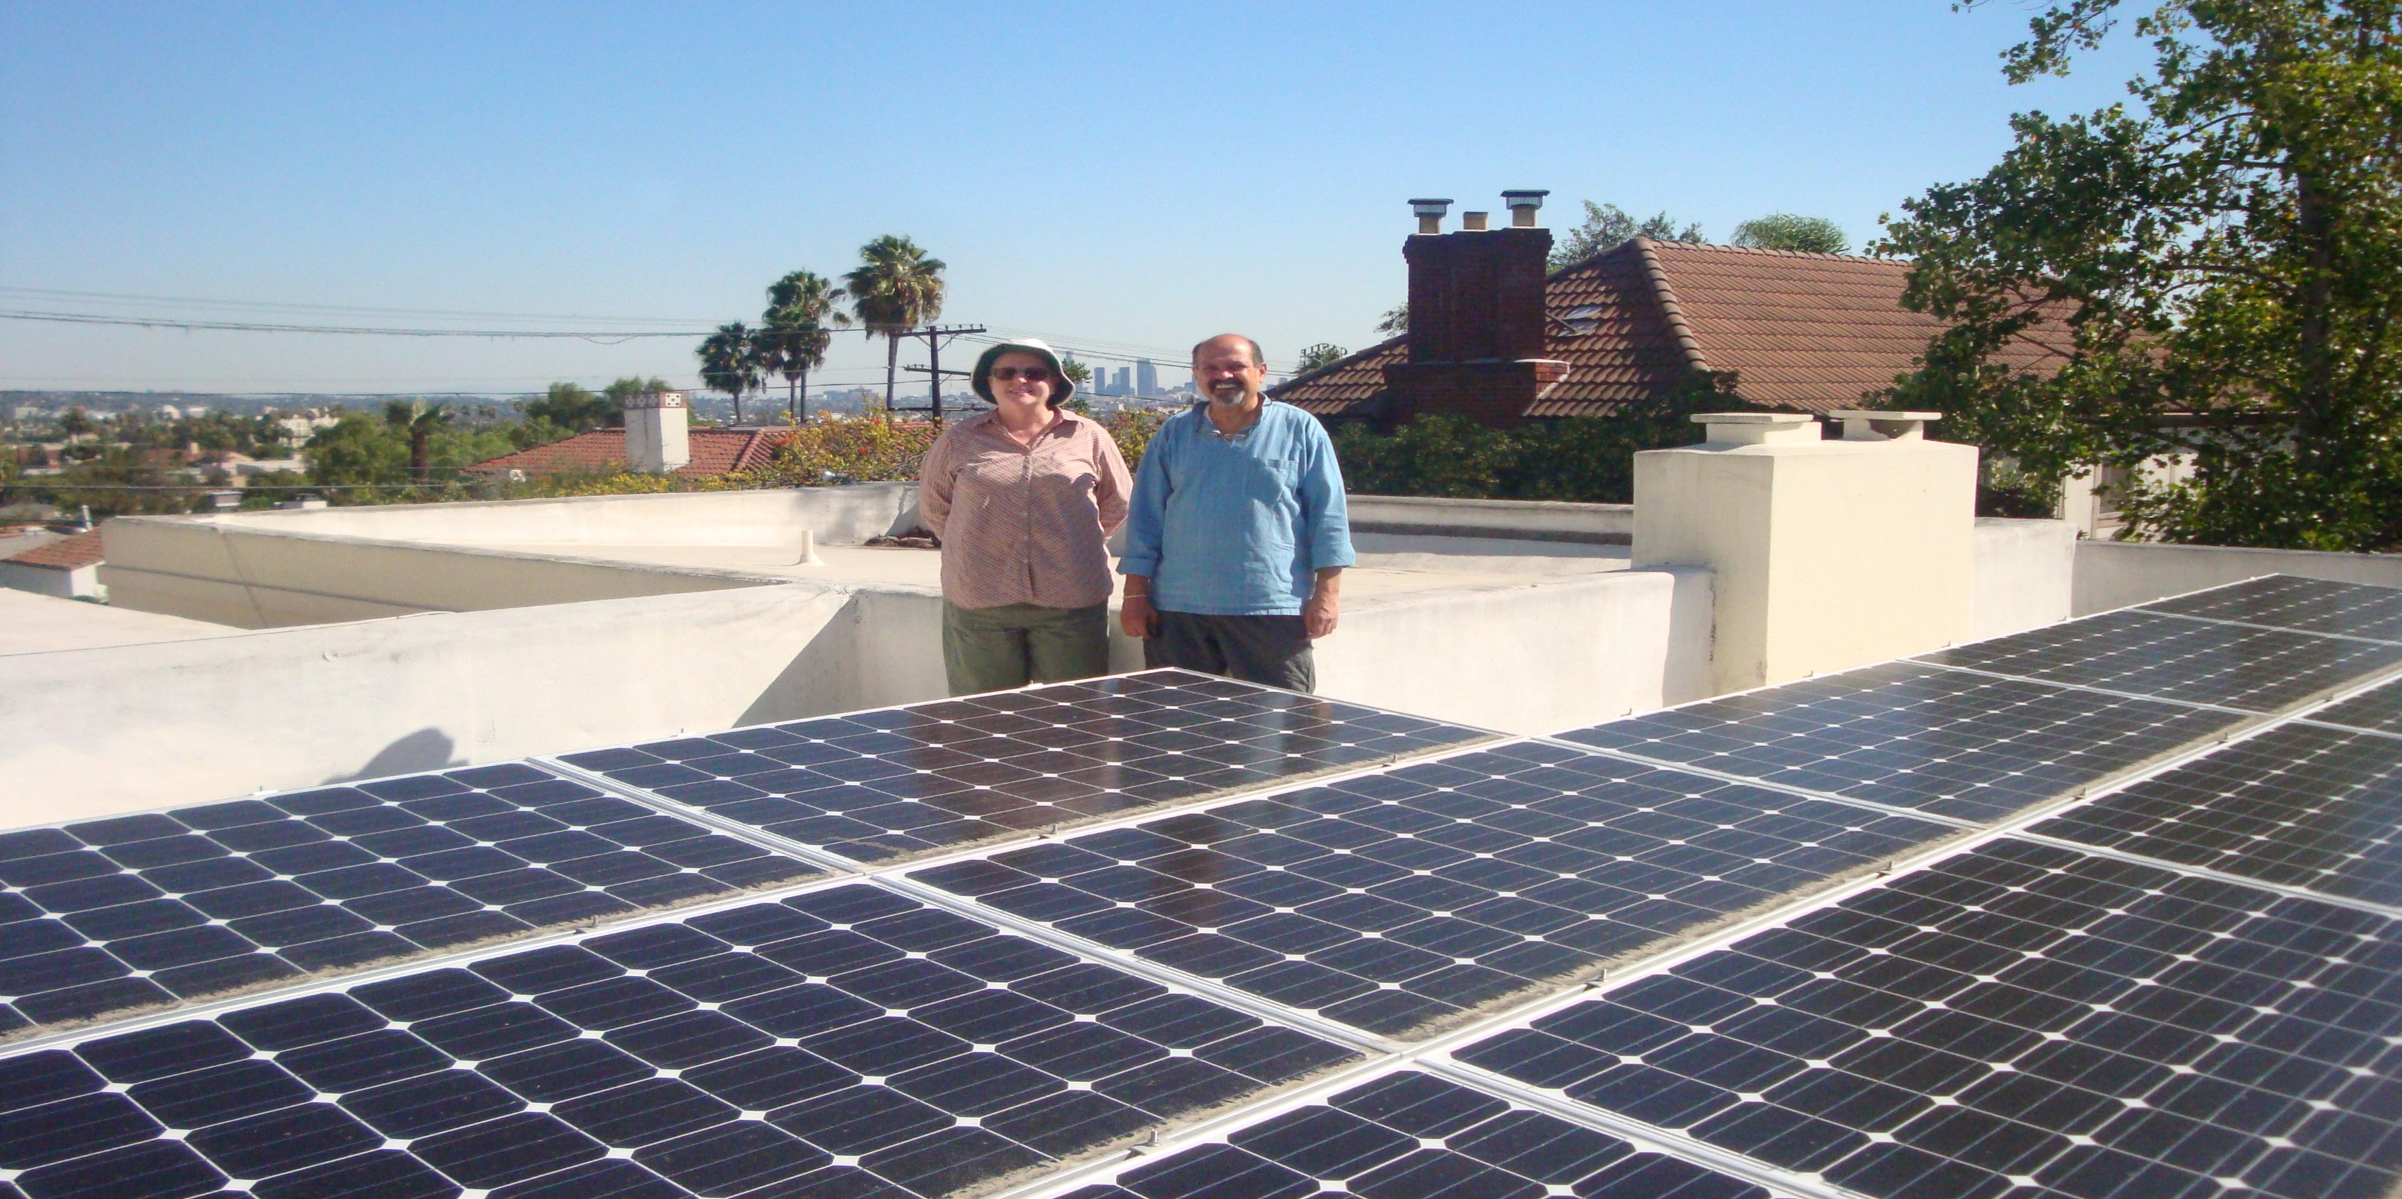
RENEWABLE ENERGY
Notes:
in an area of Los Angeles that receives more than its fair share

Slide 11
EDUCATION

Slide 12
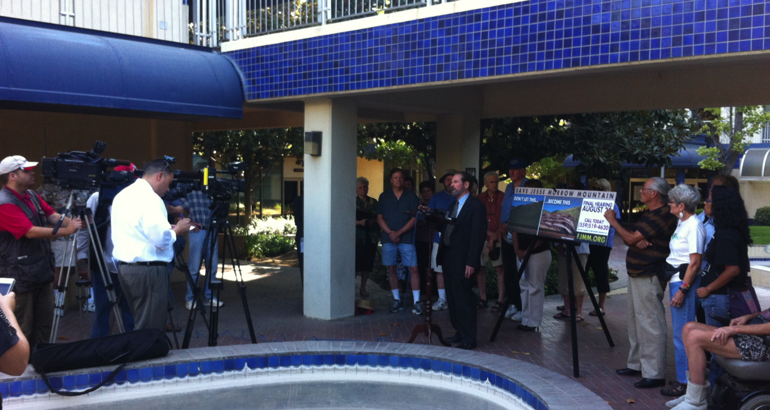
EDUCATION

Slide 13
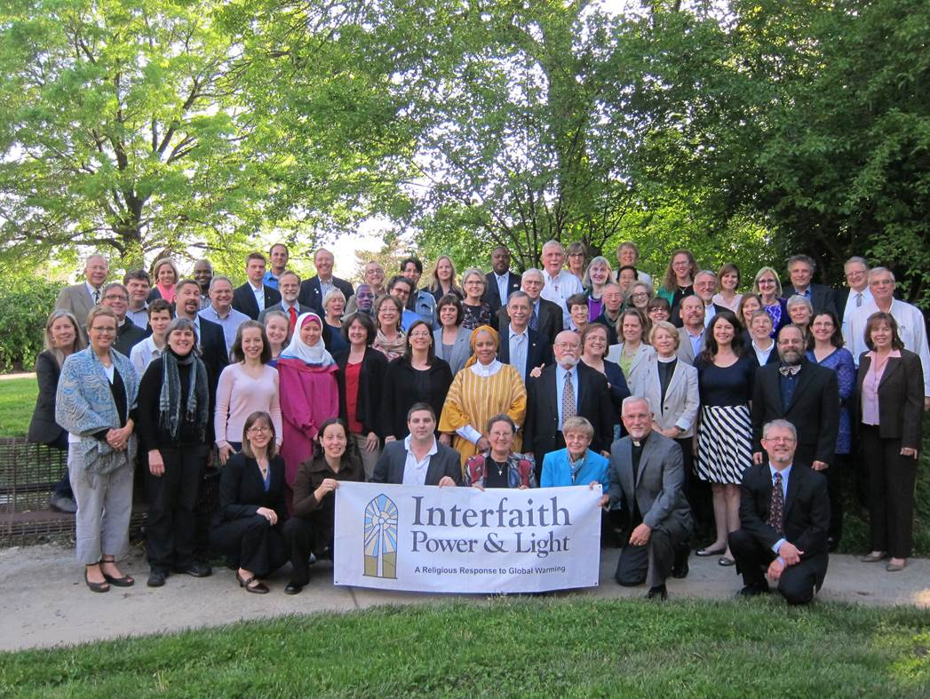
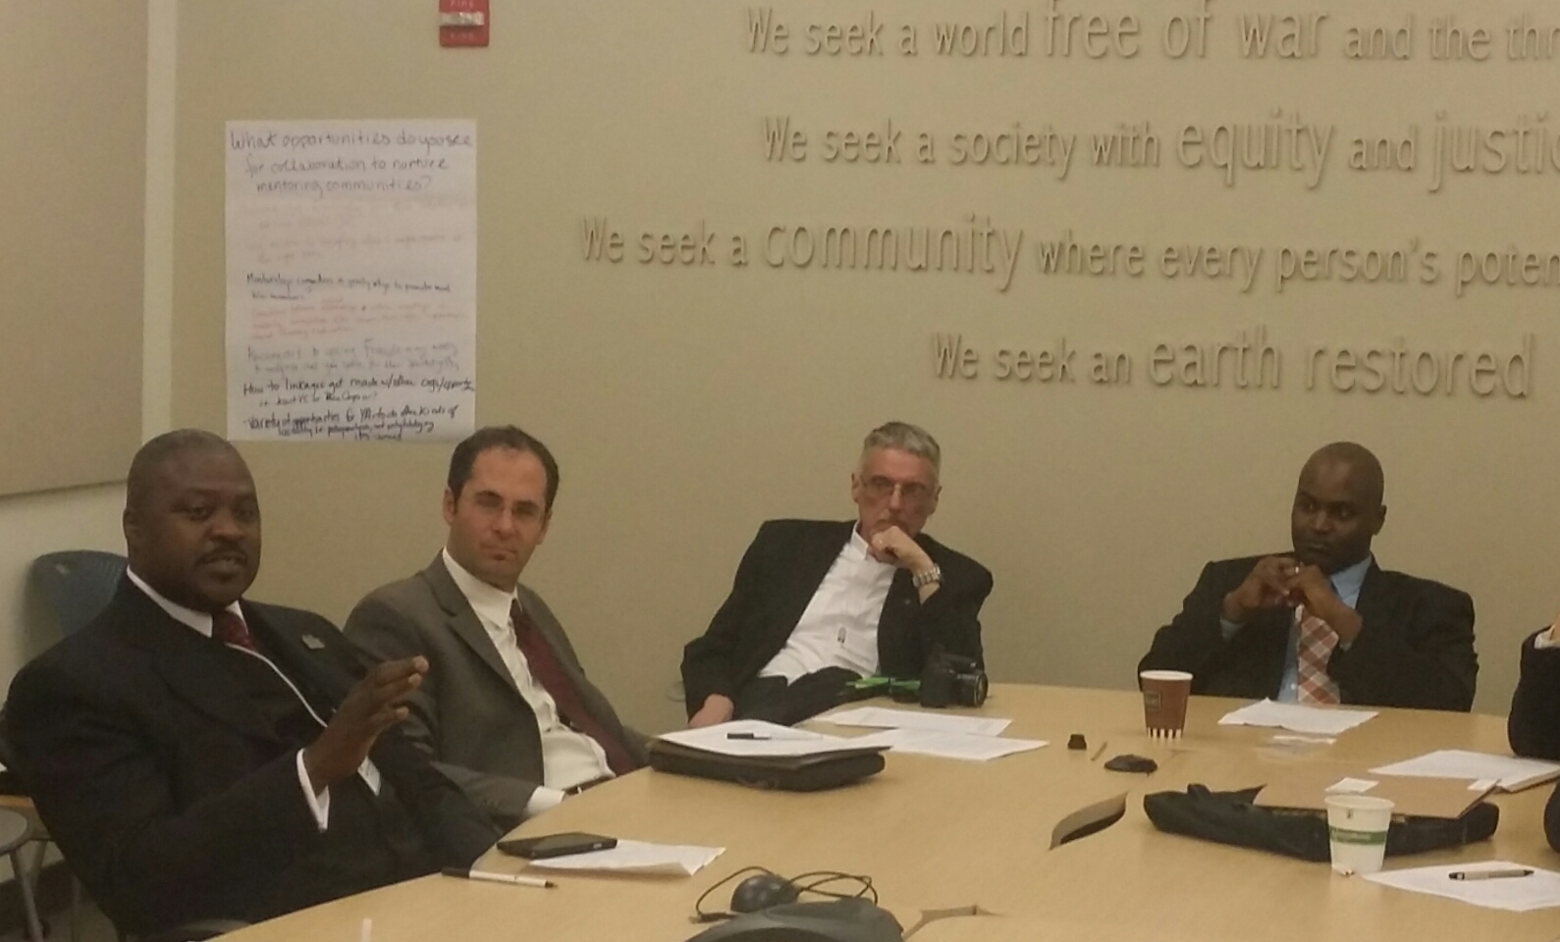
ADVOCACY
2014 DC Conference Group
Lobby Visit Debrief Session
Notes:
INCLUDE AB 32/SB 535
CAP AND TRADE IS WORKING IN CALIFORNIA
FEE AND DIVIDEND A POSSIBILITY WHICH YOU WILL HERE MORE OF

Slide 15
Water Conservation as a Spiritual Practice
Practical Measures
Water Audit – DIY/Water Company
Low-flow toilets/no-flow urinals – rebates
Replace aeroators
Rain barrels – (est. relationships, Tree People)
Permable concrete
Drought-tolerant landscaping/replace lawn
Earth care events highlighting water
Repair leaky faucets, hoses, etc
Incorporate sacred water practices into services
Household water-saving tips
Utilize HE washers (rebates)
Greywater measures
Notes:
Story about KJ waiting behind a corner and telling me about waterless urinals
CALL YOUR UTILITY COMPANY; CHECK OUT REBATES/INCENTIVES
JOIN CIPL; GET RESOURCE PACKET

Slide 16
Assess Your Congregation
Take the survey “Becoming a Green Justice Congregation.” http://www.ucc.org/environmental-ministries/just-green-congregations.html
From IPL: Use the congregational start up kit: http://www.coolcongregations.org/start-up-kit/
I also recommend the start up kits for households for individuals: http://www.coolcongregations.org/start-up-kit/for-households/

Slide 17
Greening our worship:

Slide 18
Sacraments
Baptism: Water
Tertullian: “Christ is never without water.”
Eucharist --Thanksgiving that connects Christ’s death and resurrection to Earthen elements: food and drink

Slide 19
Tonglen (Taking and Giving)
I pray this prayer as pre-communion remembrance:
“I take the grace of this communion not for myself but for those who are homeless and poor, those suffering from water and violence, and for the Earth which has so ravaged and exploited by humanity. May the grace from this communion be given to the healing of the world.”

Slide 20
Worship through the Year
Climate Change Sunday (2nd week of February) Guest Preacher
During Holy Week: Green Seder for the Earth on Holy Thursday or an Earth Tenebrae (The Stations of the Cross) for Good Friday
Easter: Jesus is raised from the dead in a Garden. God and Holy Spirit as Gardener
Earth Day Sunday (closest to April 22) Guest Speaker or an Earth-centered Event

Slide 21
Season of Creation http://seasonofcreation.com/calendar/
The basic pattern for this calendar is:
September 1 – Day of Creation (as in Orthodox traditions)

Slide 22
Four Sundays – four domains of creation e.g, Forest, Land, Ocean and River Sundays
St Francis of Assisi Day—1st Sunday of October—also the Blessing of the Animals

Slide 23
Some Additional Ideas
Add a sermon during Lent or Advent
The Baptism of Jesus: Jesus and Water Conservation and Water as a Human Right Check a few of my green sermons at: https: www.mischievousspiritandtheology.com/
Christmas Eve: Sermon from the Eyes of the Animals

Slide 24
How to read the Bible from a eco-theology point of view? Earth Bible Project
http://www.webofcreation.org/earth-bible/the-earth-bible-project

Slide 25
Introducing Ecological Hermeneutics, Norman Habel
The universe, Earth and its components are a part of dynamic cosmic design within which each piece has a place to play in the overall goal of that design.
Earth is a balanced and divine domain where responsible custodians can function as partners with, rather than rulers over Earth, to sustain its balance and a diverse Earth community.
Earth and its components not only suffer from human injustice but actively resist them in the struggle for justice.

Slide 26
There are six “green” or creation-centered principles that we need to be aware of when we read the Bible.
The universe, the Earth and all its components have intrinsic worth. All creation is loved by God.
The Earth is a community of interconnected living things that are mutually dependent on each other for life and survival.
The Earth is a subject capable of raising its voice in celebration and against injustice.

Slide 27
Hear the words of the Lord, O people of Israel, for the Lord has a case against the inhabitants of the land. There is no faithfulness and loyalty, and no knowledge of God in the land. Swearing, lying, murder and stealing and adultery break out; bloodshed follows bloodshed. Therefore the land mourns, and who live in it languish, together with the wild animals and the birds of the air, even the fish of the sea. (Hosea 4:1-3)

Slide 28
The Earth voices its indictment against humanity.
human recklessness in mountain top harvesting of coal or fracking or toxic waste dumbing
destroying the environment,
harming animal life and human beings alike for greed of energy. Here in Hosea we hear the land

Slide 29
“God so loved the world (cosmos) that God gave God’s only Child so that everyone who believes in God may not perish but may have eternal life.” John 3:16

Slide 30
Resources Worship
Season of Creation: http://seasonofcreation.com/
Sacred Texts on Green Issues: CA Interfaith & Power: http://www.interfaithpowerandlight.org/clergy-corner/sacred-texts-with-creation-care-themes/
UCC Environmental Justice Links: http://www.ucc.org/environmental-ministries_environmental-justice-links
Weekly Lectionary Readings from an Earthcare Context: http://www.letallcreationpraise.org/

Slide 31
Green Faith: http://www.greenfaith.org/resource-center/spirit/greenworship-resource/christian-resource-1/christian-web-based-resources/web-resource-full-listing
Bible and Ecology: http://www.bibleandecology.org/preaching-resources/sample-sermons

Slide 32
Congregational Education
Renewal: Stories from America’s Religious-Environmental Movement(DVD) Across the nation, people of faith are standing up for the environment. Evangelical Christians are fighting mountaintop removal, a coal mining process that is decimating Appalachia. Muslims are supporting sustainable farming. Jews are helping children experience the bond between nature and spirituality. Interfaith Power and Light is mobilizing people of all faiths in a religious response to global warming. For the first time, the combined energy of these diverse activists is the driving force behind a feature-length documentary, entitled RENEWAL. Veteran film producers Marty Ostrow and Terry Kay Rockefeller have crisscrossed the country to capture these exciting stories of people whose passion and deep moral commitment are making a difference in a time of grave ecological threats. Purchase at Interfaith Power & Light
http://www.interfaithpowerandlight.org/resources/films/

Slide 33
Discussion Forums:
Show of one of the Renewal Stories (8-14 minutes)
Listen to congregants’ responses and ideas
Use the resources for an educational program from the following slides

Slide 34
Other Videos
Inconvenient Truth with Al Gore (youtube—entire movie is in parts), purchase, or rent from amazon.com
Earth 2100 (ABC graphic novel) DVD or can be watched on youtube. It is free to watch.
Chasing Ice (documentary) by James Balog

Slide 35
Introduction: Falling in Love with God, Rev. Dr. Bob Shore-Goss https://www.youtube.com/watch?v=deOVqVEGv08
State of the Earth, Part 1 Rev. Dr. Bob Shore-Goss https://www.youtube.com/watch?v=ExLSvJXWjlQ
State of the Earth, Part 2, Rev. Dr. Bob Shore-Goss https://www.youtube.com/watch?v=-e2oOB2sqrA

Slide 36
Other Resources
Charlene Hosenfeld, Eco-Faith: Creating & Sustaining Green Congregations, Cleveland, The Pilgrim Press, 2009.
Environmental Justice Ministries http://www.ucc.org/environmental-ministries_about-us
Interfaith Power & Light http://www.interfaithpowerandlight.org/

Slide 37
Virtual Tour: Explore the UCC Environmental Ministries http://www.ucc.org/environmental-ministries/ The UCC has a phenomenal internet site on environmental ministries and resources. Play, explore, learn, and follow where your interest and the Spirit lead you.
Checkout the Massachusetts Conference on Environment/Climate Justice http://www.macucc.org/environment
(This is good example of a conference website on environment/climate change). If your conference does not have such a resource, you can create on for your conference.

Slide 38
Green Congregations CIPL (California Interfaith Power & Light) Allis Druffel
https://www.youtube.com/watch?v=rJYYHBhMYEU
Greening Congregation CIPL Part 2, Allis Druffel
https://www.youtube.com/watch?v=j9lnEfp_9hA

Slide 39
Greening your Campus, Part 1 Rev. Dr. Bob Shore-Goss
https://www.youtube.com/watch?v=TPuCEr1lClQ
Greening your Campus, Part 2, Rev. Dr. Bob Shore-Goss
https://www.youtube.com/watch?v=FXODDBieD6I

Slide 40
Subscribe to e-news Or have individual folks subscribe and report on important events
Environmental Defense Fund www.edf.org
Earth First www.earthfirst.org
Sierra Club www.sierraclub.org
Audubon Society www.audobon.org
Citizens for Planet Earth http://www.tryscience.org/csp/csp.html

Slide 41
More sites
Green Peace http://www.greenpeace.org/usa/en/
PETA http: www.peta.org/
Eco-Jesuit http://www.ecojesuit.com/
Interfaith Power & Light http://www.interfaithpowerandlight.org/

